Slide 1
Tutorial 5 : Clustering OTUs
Joseph Stewart, Benjamin Sauerwald, Alejandro Mateo

Slide 2
USEARCH ALGORITHM
The USEARCH algorithm searches a database for high-identity hits to one or more database sequences ("targets").
The recommended identity ranges for usearch effectiveness is ~50% and above for proteins and ~75% and above for nucleotides.
Faster than BLAST in practical applications, though sensitivity to distant protein relationships is lower.
https://www.drive5.com/usearch/manual/usearch_algo.html
https://pubmed.ncbi.nlm.nih.gov/20709691/

Slide 3
How it works
Word counts and U-sorting
USEARCH exploits that fact that similar sequences tend to have several short words in common of a fixed length k (kmers).
- Unlike other algorithms that use kmers, USEARCH does not estimate sequence identity from the number of matching kmers.
- Instead, USEARCH uses the word count to prioritize the database search.
Target sequences are compared to the query in order of decreasing unique word count (U).
If a hit above the identity threshold exists in the database, it is likely to be found close to the start of the U-sorted list of targets (the "U vector").
https://www.drive5.com/usearch/manual/usearch_algo.html
Notes:
USEARCH does not estime sequence identity from # of matching kmers because identity correlates only approximately with the word count and does not give an accurate estimate, especially for lower identities.

Slide 4
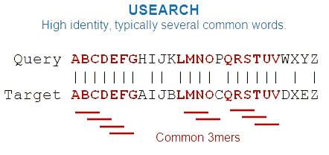
Usearch Algorithm
Let T1, T2 be the database sequences (targets)
Q be the query sequence
w is the word size (by default, w=8 for nucleotides and w=5 for amino acids)
W(S) be the set of words of length w in sequence S
sim(S,T) be the similarity of sequences S and T
(t) is the identity threshold
Targets are compared to Q in order of decreasing Ui = |W(Q) ⋂ W(Ti)| (the number of unique words in common between Q and the ith database sequence)
Sequences are compared based on statistics of shared words instead of aligning them.

Slide 5

Identity Threshold
The -id option specifies the minimum sequence identity of a hit.
It is a fraction of columns in an alignment with matching letters
The fraction is represented as a number between 0.0 and 1.0, or percentage.
Example
usearch -cluster_fast reads.fasta -centroids c.fasta -id 0.90
Terminal gap of length 3 at the end of the alignment
Threshold is calculated from the remaining seven columns which contain six matches so the identity is 6/7 = 0.86.
https://www.drive5.com/usearch/manual/opt_id.html

Slide 6
Accepts and Rejects
An "accept" is a target sequence that is above the identity threshold so can be considered a hit.
A "reject" is a target sequence that is compared to the query but falls below the threshold.
When comparing the targets to the query:
Since U correlates well with similarity (Ui = |W(Q) ⋂W(Ti)|),
(i) the first hit that is found is likely to be the best hit that exists in the database, or close to it, and
(ii) the more rejects that have occurred without a hit, the less likely it is that a hit exists.
The search can be terminated early if (i) a hit is found, or (ii) several rejects have occurred
The commands maxaccepts and -maxrejects determine when the search is stopped
This technique can improve speed which is an advantage when dealing with very large sequence datasets.
https://www.drive5.com/usearch/manual/usearch_algo.html

Slide 7
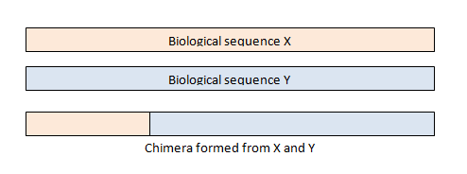
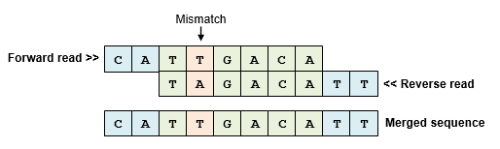
VSEARCH vs. USEARCH
VSEARCH has been shown to be a fast, accurate and full-fledged alternative to USEARCH.
VSEARCHis in general more accurate than USEARCH when performing searching clustering, chimera detection and subsampling.
VSEARCH is faster than USEARCH when performing replication and merging of paired-end reads, but slower for clustering and chimera detection.
VSEARCH is both open source and free of charge which is beneficial for end-users and can motivate research activities.
Chimeras (sequences formed from two or more biological sequences joined together)
Paired read merging ( forward and reverse reads that overlap, can be merged to give a single sequence
https://www.ncbi.nlm.nih.gov/pmc/articles/PMC5075697/

Slide 8
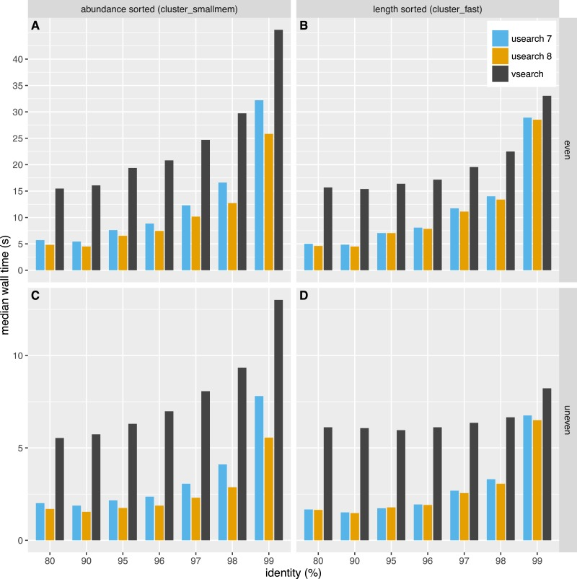
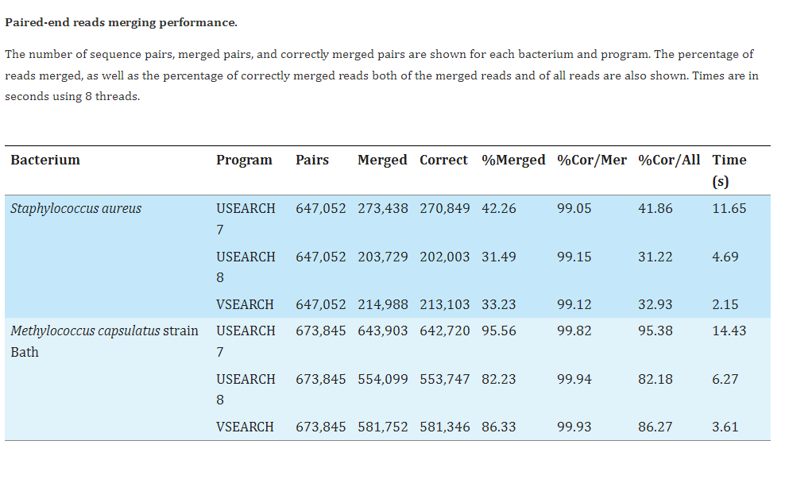
VSEARCH vs. USEARCH
VSEARCH is about twice as fast as USEARCH 8 and 4–5 times faster than USEARCH version 7.
VSEARCH is in the middle by merging more reads than USEARCH 8 with only a small decrease in the percentage of correct merges
VSEARCH vs. USEARCH clustering speed
USEARCH programs is in general 2–3 times faster than VSEARCH.
Difference in speed is smaller for higher thresholds, especially at 99% similarity
https://www.ncbi.nlm.nih.gov/pmc/articles/PMC5075697/

Slide 9
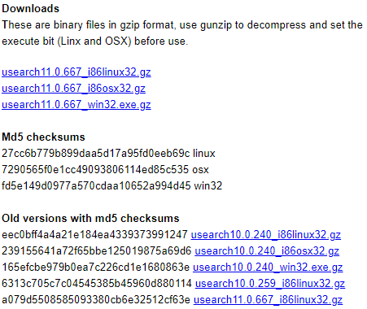

Code Implementation
As of now, the most recent version of usearch is 11.0.667
The tutorial was designed for 10.0.XXX
Implementation of vsearch is not one-to-one with usearch
Notes:
Ben

Slide 10

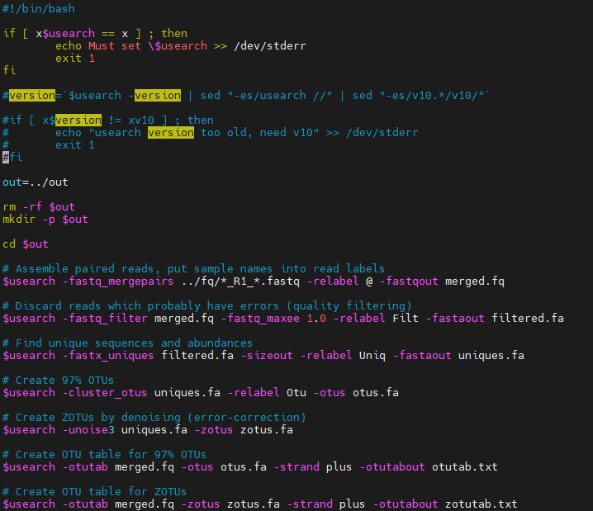
run.bash
While not technically part of the tutorial, this code was provided to generate the pre-computed files for the exercises
The version check is commented out, as the tutorial is out of date
Notes:
Ben

Slide 11
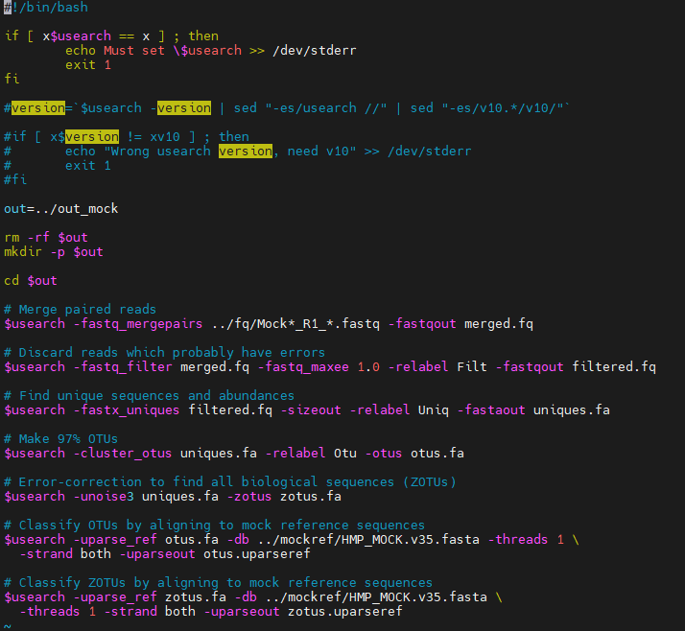
run_mock.bash
Functionally indistinguishable from the previous step, but uses mock data instead
Notes:
Ben

Slide 12
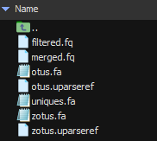
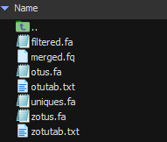
Scripts output
The previous scripts generate the following files in “..\out\” and “..\mockout\”
OTU Table for 97% OTUs
OTU Table for ZOTUs
Notes:
Ben
Operational Taxonomic unit
Zero Radius operational taxonomic unit

Slide 13
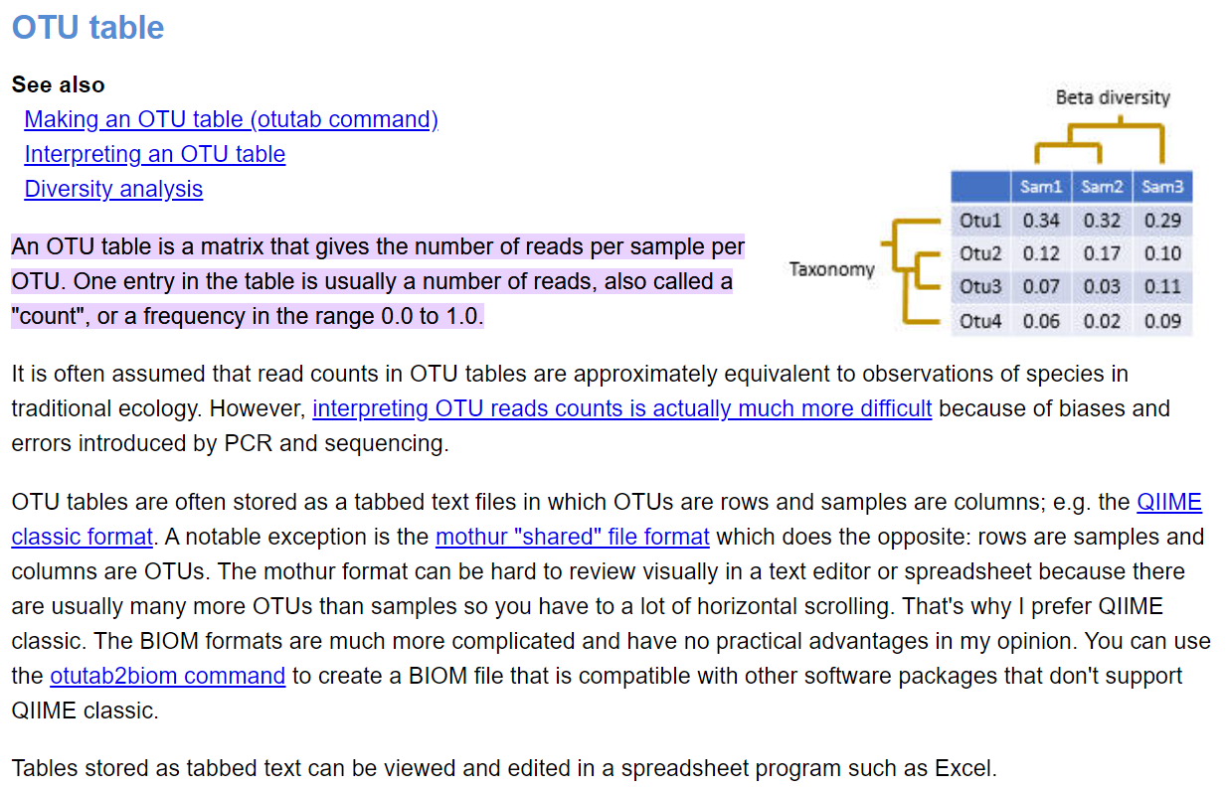
OTU Tables
Notes:
Ben
These generated OTU tables provide the similarity between the OTUs and samples they are checking against. However, next slide

Slide 14
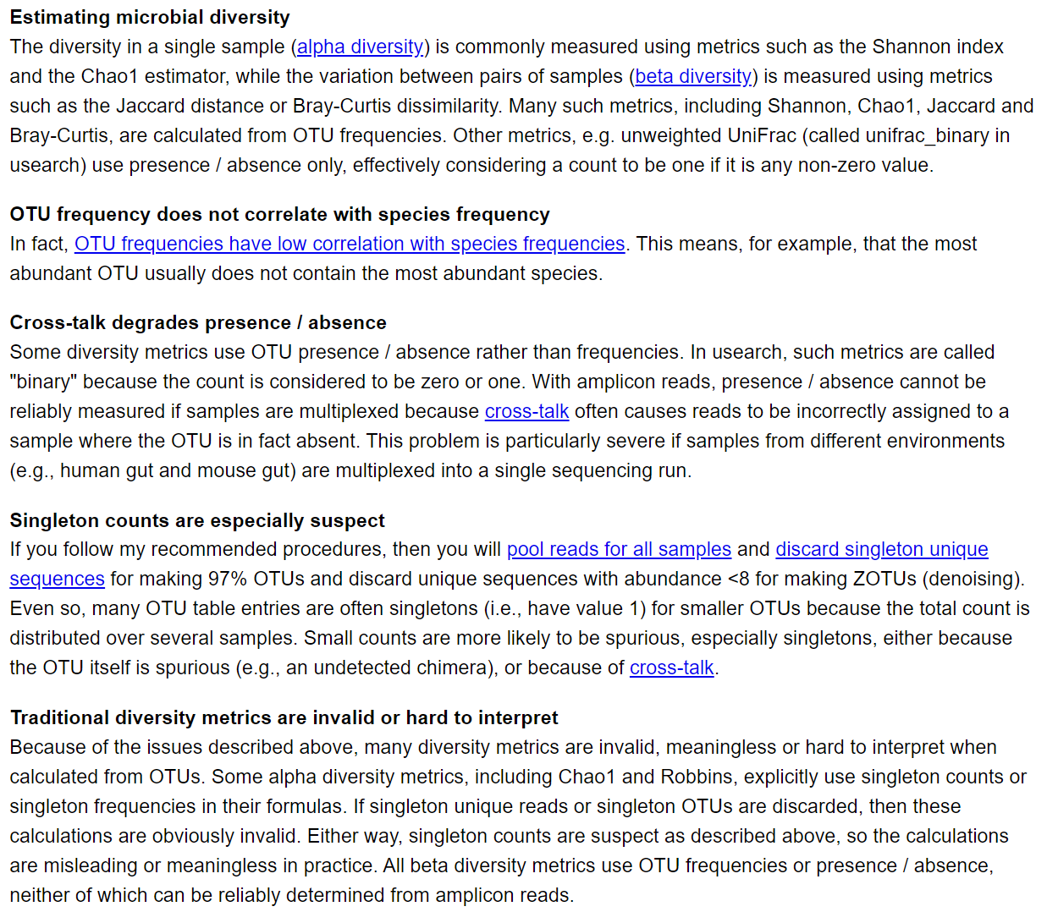
OTU Tables
Multiple factors affect the interpretation of the OTU table
Notes:
Ben

Slide 15
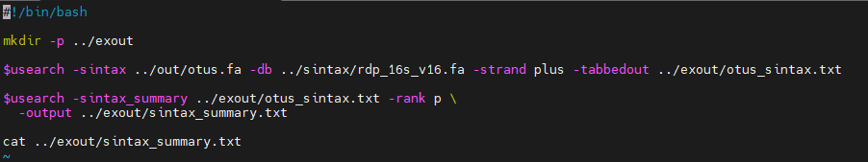
Exercise 1
“Write a script that runs the sintax command to predict taxonomy for the OTU sequences. Use the reference database in the sintax/ sub-directory of the tutorial. Look at the results for the top three OTUs (Otu1, Otu2 and Otu3). What is the phylum for these OTUs? What are their boostrap confidence values for genus? Optional: Run these three OTU sequences at the NCBI BLAST web site. If 95% identity is roughly the threshold for genus, can you assign a genus to these sequences from the BLAST hits?“
OTU1 Phylum: Bacteroidetes, OTU2 Phylum: Bacteroidetes, OTU3 Phylum: Bacteroidetes
OTU1 Confidence: 36%, OTU2 Confidence: 46%, OTU3 Confidence: 55%
Notes:
Ben
The sintax algorithm predicts taxonomy for query sequences and presents them in a FASTA or FASTQ format. Exercise 1 uses this algorithm in the attached script to search for the OTU sequences hits. It provides the meta data and using that can be cross referenced against BLAST.

Slide 16
Exercise 1 BLAST
OTU 1:
OTU 2:
OTU 3:
Confidence on OTU1 >95%, so we could identify a genus
Notes:
Ben

Slide 17
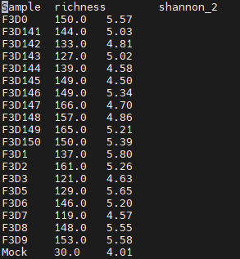

Exercise 2
“Write a script which runs the alpha_div command to calculate the richness and Shannon metrics. Use bits (base 2) for Shannon. What is the richness and Shannon diversity of the mock sample?”
Richness: 30
Shannon diversity: 4.01 bits (rounds to 5)
Notes:
Ben
The second exercise uses the alpha_div command, which calculates one or more alpha diversity metrics for all samples in the OTU table. For this exercise we are using it to calculate the richness and shannon metrics.

Slide 18
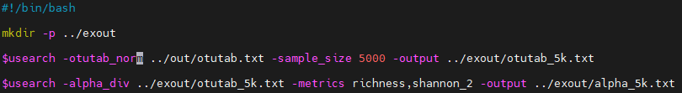
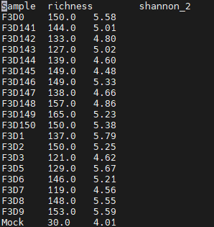
Exercise 3
“Write a script which runs the otutab_norm command to normalize all samples to 5,000 reads, then calculate the richness and Shannon diversity on the normalized OTU table. Compare the richness and Shannon diversity of the mock sample to the values obtained in Exercise 2. Did they change? Explain why the values did or did not change.”
The richness/sample diversity did not change because normalizing does not affect if an OTU is present in a sample (alpha diversity) or its frequency (Shannon diversity)*
Notes:
Ben
The otutab command generates its own OTU table by mapping reads to OTUs. We are using it to normalize all samples to 5000 reads. From there richness and shannon metrics are calculated again. The point of this is to determine if the normalization affected the metrics at all. As can be seen, the values did change slightly due to rounding, but their overall value remained the same.

Slide 19
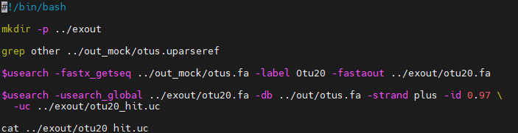
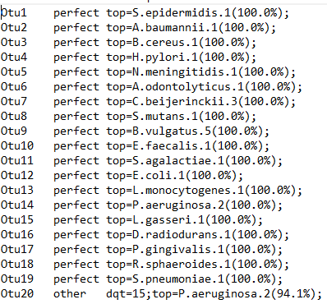
Exercise 4
“Look at the otus.uparseref file in the misop/out_mock directory. Which OTU does not match a reference sequence for the mock community? (Hint: see uparseout option for description of the file format). Make a FASTA file with this sequence and use the usearch_global command to find the same sequence in the OTU file for all samples combined (out/otus.fa). Which is the corresponding OTU? What reason(s) could explain why this unexpected sequence is found in reads for the mock sample?”
OTU20 in out_mock\otus.fa is annotated as ‘other’, and is identical to OTU107 in out\otus.fa, likely due to cross-talk/contamination.
Notes:
Ben
The uparseout_option provides a tabbed output file with 5 or six fields. Combined with the usearch_global command, we can find the sequence that was a “hit” for not matching a sequence in the mock community.
That output translates to “There is a Hit at index 106. It has out of the 253 length string being queried, a 100% match rate. +/- means nucleotides. We ignore zeros, but the compressed length of the Match is 253 nucleotides between the query of OTU20 and the match of OTU107”

Slide 20
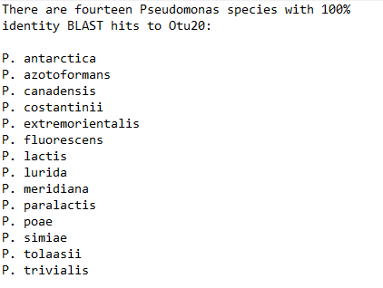
Exercise 5
“Run the OTU sequence from Exercise 4 at NCBI BLAST (See: How to BLAST a 16S sequence). Which species (singular or plural) have BLAST hits with 100% identity? (You can find the OTU sequence in exercises/otu20.fa if needed).”
Notes:
Ben
Outside of picotte, this exercise has us running the “hit” from exercise 4 through BLAST.

Slide 21

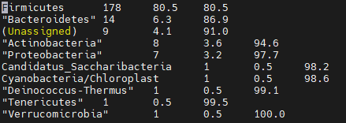
Exercise 6
“Write a script to run the sintax_summary command for phylum rank. Which is the most common phylum in the OTUs?”
Firmicutes had 178 OTUs, with the next most plentiful phylum having 14
Notes:
Ben
Finally, we are using the sintax command again. The modifiers we are using this time creates a summary report for the algorithms predictions based on the frequency of each named taxon at the given rank. For this exercise we are using the phylum rank. As can be seen here, the most common phylum is Firmicutes.

